Slide 1


Enhancing Gaming Experience with Computer Vision: Leveraging MediaPipe and Python

Slide 2
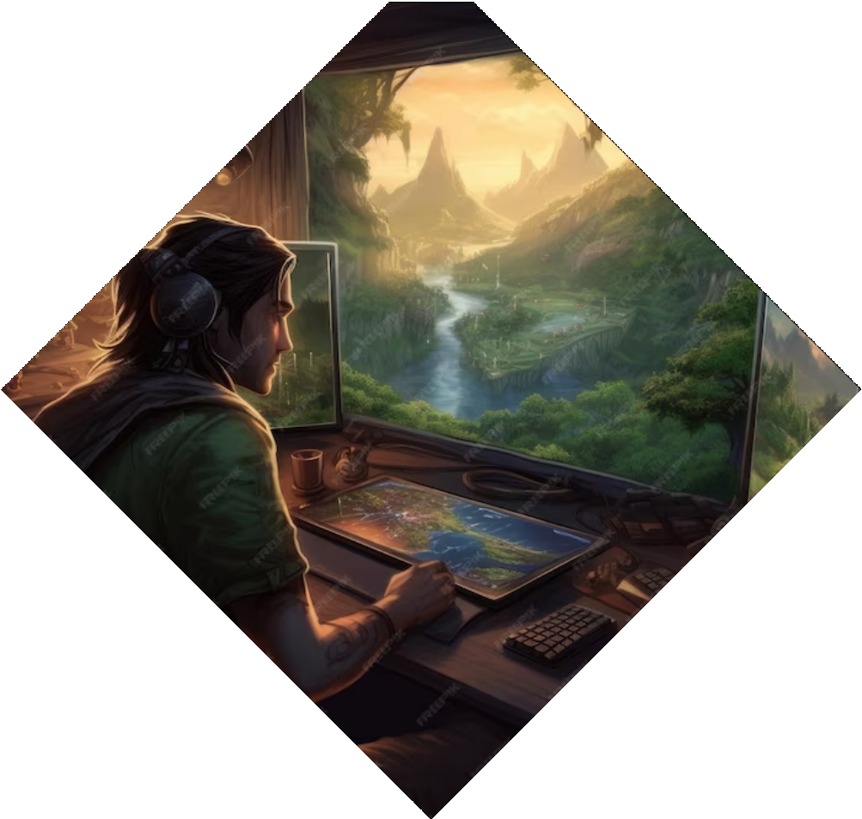
Introduction
Welcome to the presentation on Enhancing Gaming Experience with Computer Vision: Leveraging MediaPipe and Python. In this presentation, we will explore the powerful combination of computer vision, MediaPipe, and Python to revolutionize the gaming experience. We will discuss the beneﬁts, applications, and potential of this technology. Let's dive in!

Slide 3
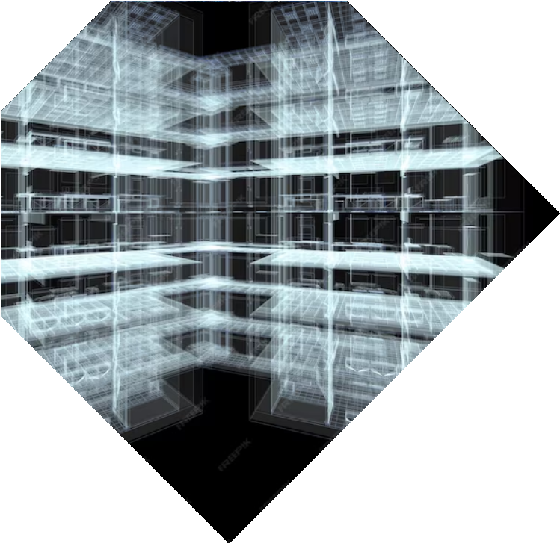
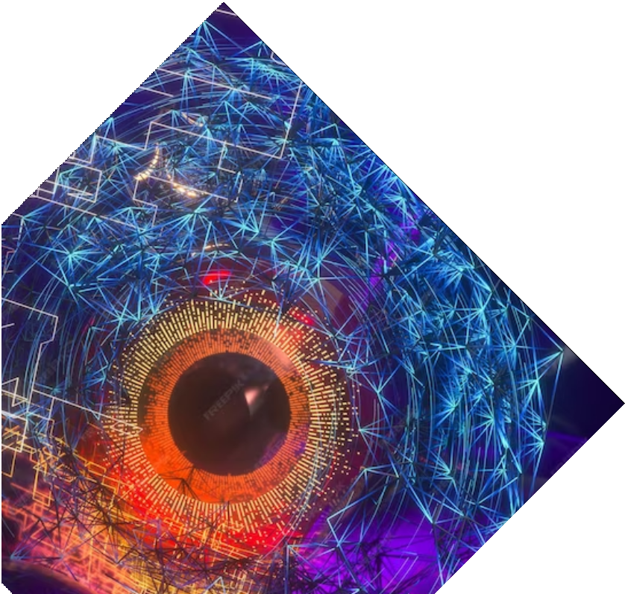
What is Computer Vision?
Computer Vision is a ﬁeld of artiﬁcial intelligence that focuses on enabling computers to understand and interpret visual information from images or videos. It involves tasks such as object recognition, tracking, and motion analysis. By leveraging computer vision techniques, we can enhance gaming experiences by introducing real-time interactions, gesture recognition, and immersive visual effects.

Slide 4

MediaPipe: An Overview
MediaPipe is an open-source framework developed by Google that provides a comprehensive solution for building real- time multimedia processing pipelines.
With MediaPipe, developers can easily integrate computer vision algorithms into their applications. It offers a wide range of pre-built models and tools, making it an ideal choice for enhancing gaming
experiences.

Slide 5


Python and MediaPipe
Python, a popular programming language, offers excellent support for MediaPipe. With Python, developers can leverage the simplicity and ﬂexibility of the language to build robust gaming applications.
MediaPipe provides Python APIs that allow seamless integration of computer vision algorithms, enabling developers to create immersive gaming experiences with ease.

Slide 6
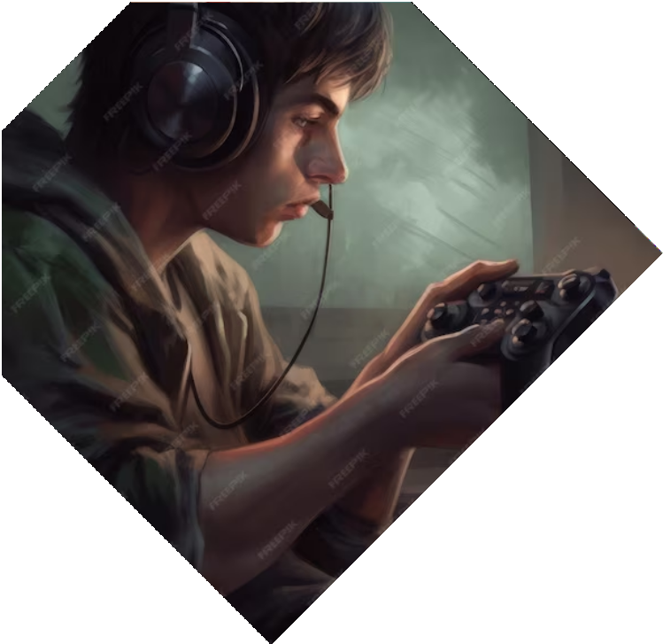
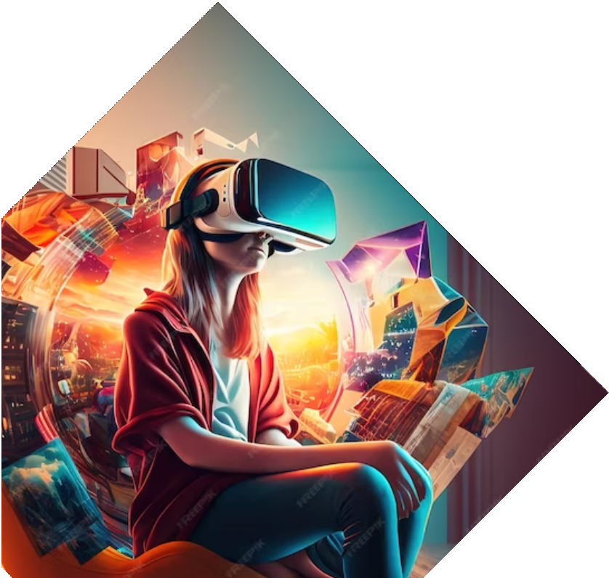
Enhancing Interactions with Computer Vision
Computer vision enables us to enhance gaming interactions by introducing gesture recognition. By analyzing the player's movements, we can create responsive gameplay experiences.
Whether it's controlling characters through hand gestures or using facial expressions to trigger in-game actions, computer vision opens up a new world of interactive possibilities.

Slide 7

Real-Time Object Tracking
Real-time object tracking is another exciting application of computer vision in gaming. By leveraging MediaPipe's object tracking capabilities, we can track game objects and provide dynamic visual effects. Imagine a game where virtual objects seamlessly interact with the real world, creating a truly immersive experience for players.

Slide 8
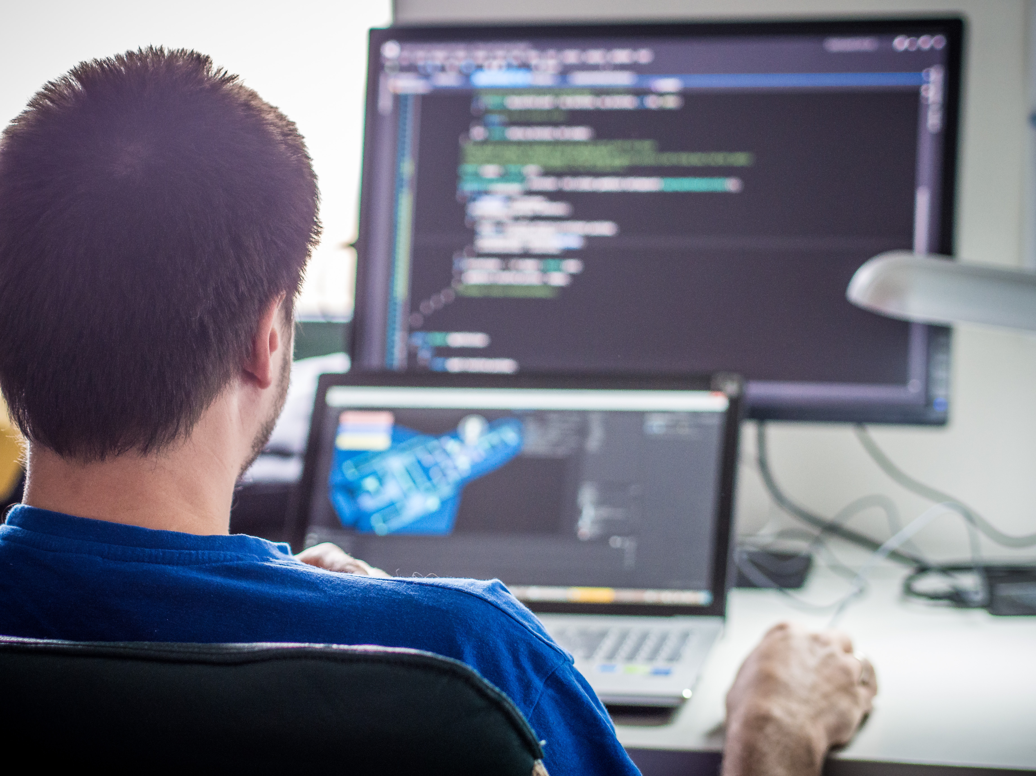

Immersive Visual E£ects
Computer vision can be used to create immersive visual effects in games. By analyzing the player's facial expressions and emotions, we can dynamically adjust the game environment, lighting, and visual effects to match the player's mood or enhance the gameplay experience.
This level of immersion takes gaming to a
whole new level.

Slide 9

Challenges and Considerations
While computer vision offers exciting possibilities for enhancing gaming experiences, there are challenges and considerations to keep in mind. These include performance optimization, handling varying lighting conditions, ensuring privacy and data security, and addressing potential biases in computer vision algorithms. By addressing these challenges, we can create safe, inclusive, and enjoyable gaming experiences for all
players.

Slide 10
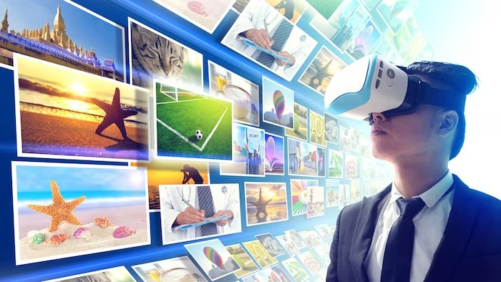
Applications of Computer Vision in Gaming
Computer vision has a wide range of applications in gaming. Some examples include virtual reality (VR) games, augmented reality (AR) games, motion- controlled games, facial recognition for personalized experiences, and real-time object detection for interactive gameplay. By leveraging computer vision, we can create innovative and captivating gaming experiences that push the boundaries of
traditional gameplay.

Slide 11
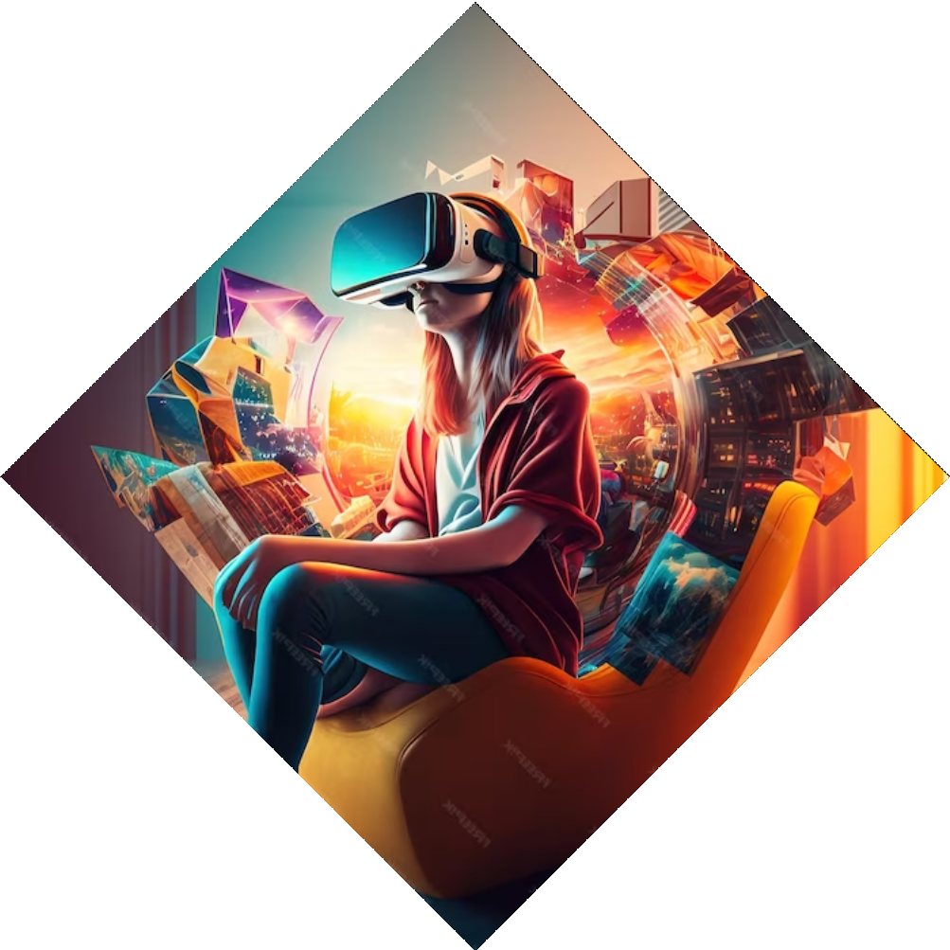
Future Possibilities
The future of gaming with computer vision is full of exciting possibilities. As technology advances, we can expect more accurate and reliable computer vision algorithms, improved hardware capabilities, and enhanced integration with other emerging technologies like machine learning and virtual reality. These advancements will pave the way for even more immersive and engaging gaming experiences.

Slide 12
Conclusion
In conclusion, leveraging computer vision, MediaPipe, and Python can signiﬁcantly enhance gaming experiences. By introducing real- time interactions, gesture recognition, and immersive visual effects, we can create captivating and immersive gameplay. While there are challenges to overcome, the future of gaming with computer vision holds immense potential. Let's embrace this technology and unlock new dimensions of gaming enjoyment.

Slide 13
Thanks!
Do you have any questions?
pankaj@gmail.com digiocean.com

